Slide 1
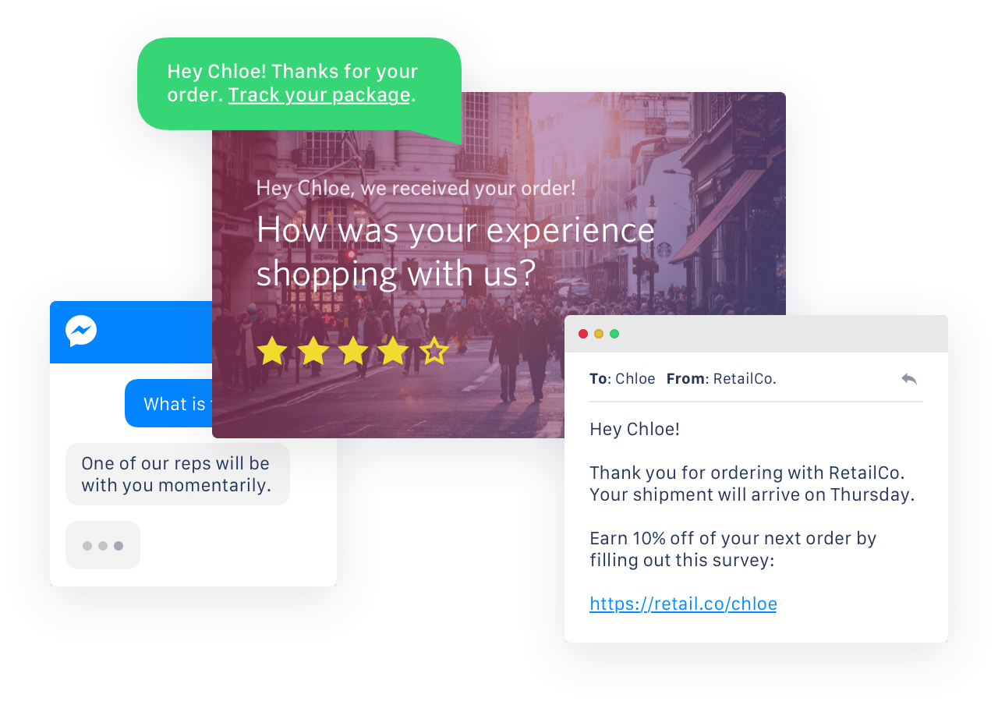
Beyond Inc.
Customer Survey Experience
Binesh Dhami, Diksha Chawla Solutions Engineer

Slide 3







Customer feedback is essential to guide and inform your decision making and influence innovations
86%
40%
90%
Pay up to 25% more for a better customer service experience
Buy from competitors because of their reputation for great customer service
Text messages are read within 3 minutes
Notes:
Customer engagement is personalized and timely communications — and it can make businesses succeed.
Whether that’s reducing your fraud costs by implementing two-factor authentication or converting leads at 3x the industry average by implementing automatic callbacks when a prospect submits a web form, or improving your CSAT by implementing a programmable Contact Center like ING has.

Slide 4
What we heard
Customized Messages
Send customized batch (bulk) messages
Cloud-based Solution
Your Main Requirements
A reliable cloud based solution without infrastructure overhead
Airtable
Backend database to hold customer details and survey responses

Slide 5
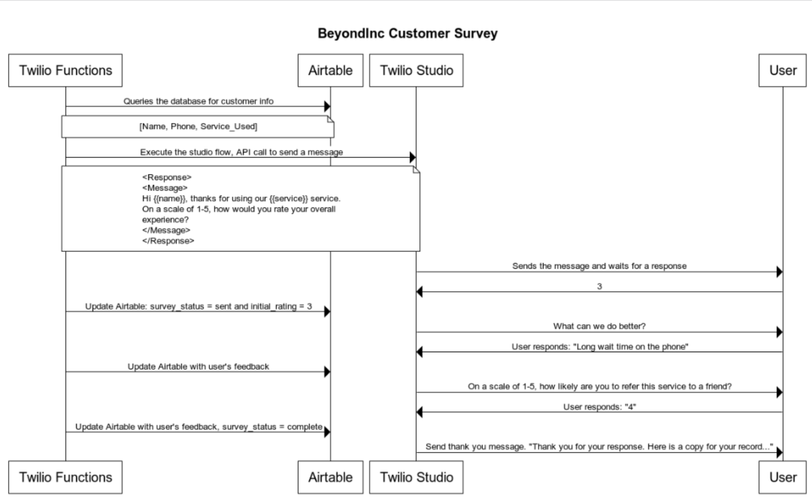
Twilio Functions
Twilio Functions is a serverless environment which empowers developers to quickly and easily create production-grade, event-driven Twilio applications that scale with their businesses.
Twilio Studio
Build flexible communications applications without spinning up servers or rallying dev ops. Use drag and drop tools alongside custom code to craft and iterate prototypes and go live quickly.
Twilio Programmable SMS API
Used behind the scenes to send and receive text messages with Twilio’s Programmable SMS API
Notes:
Tw studio: is a visual editior for creating tw apps. it works by dragging and droping widgets which represent part of the tw api and then connecting them to create an app. If you can draw your application you can certainly build one using tw studio

Slide 6
Demo

Slide 7
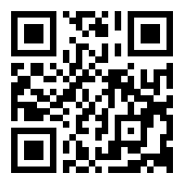
Try it yourself
Text
Text “Survey” to +1(404)-383-4821 to run through the demo
QR Code
Text or Scan the QR Code
Scan the QR Code

Slide 8
Thank You!

